Slide 1
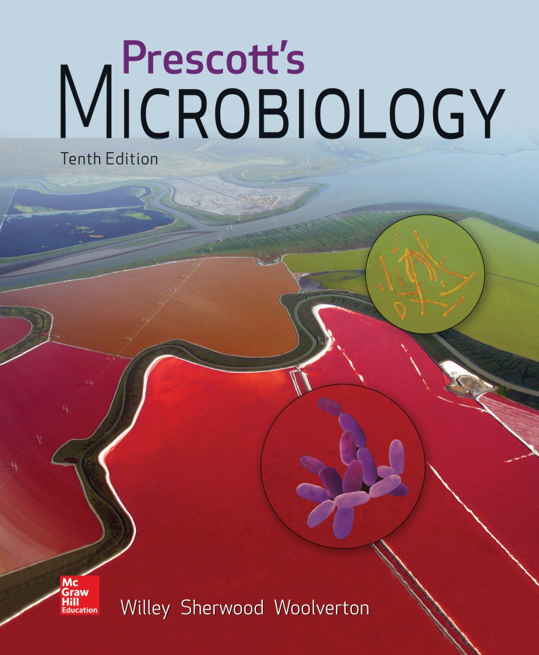
Chapter 9 – Antimicrobial Chemotherapy

Slide 2
9.1 Antimicrobial Chemotherapy Evolved from Antisepsis Efforts
Trace the general history of antimicrobial chemotherapy
Propose natural sources of new antimicrobial agents

Slide 3
Chemotherapeutic Agents
Chemical agents used to treat disease
Destroy pathogenic microbes or inhibit their growth within host
Most are antibiotics
microbial products or their derivatives that kill susceptible microbes or inhibit their growth

Slide 4
The Development of Chemotherapy
Paul Ehrlich (1904)
developed concept of selective toxicity
identified dyes that effectively treated African sleeping sickness
Sahachiro Hato (1910)
working with Ehrlich, identified arsenic compounds that effectively treated syphilis
Gerhard Domagk, and Jacques and Therese Trefouel (1935)
discovered sulfonamides and sulfa drugs

Slide 5
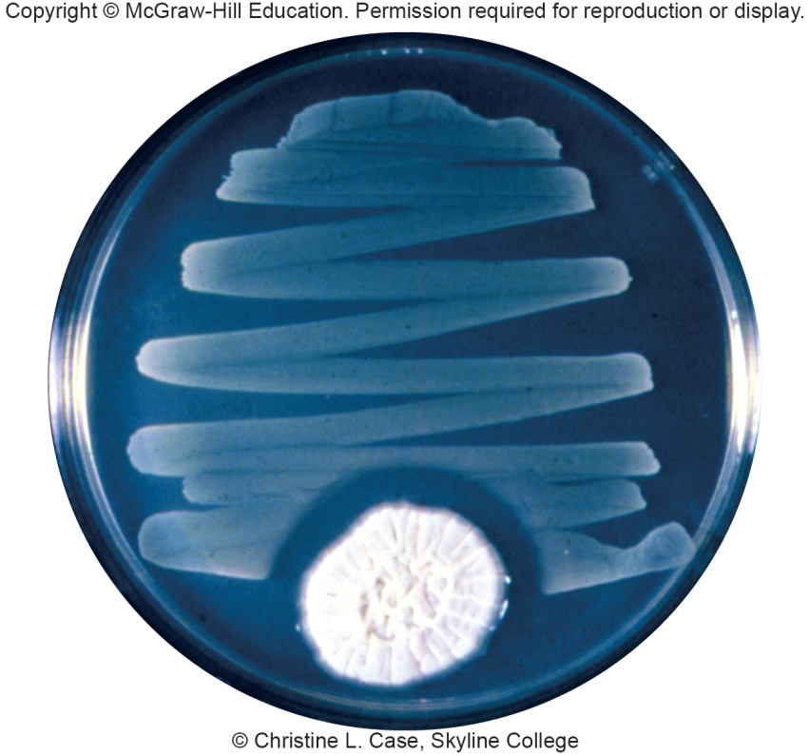
Penicillin
First discovered by Ernest Duchesne (1896), but discovery lost
Accidentally discovered by Alexander Fleming (1928)
observed penicillin activity on contaminated plate
did not think could be developed further
Effectiveness demonstrated by
Florey, Chain, and Heatley (1939)
Fleming, Florey, and Chain
received Nobel Prize in 1945
for discovery and production
of penicillin

Slide 6
Later Discoveries
Streptomycin, an antibiotic active against tuberculosis, was discovered by Selman Waksman (1944)
Nobel Prize was awarded to Waksman in 1952 for this discovery
By 1953 chloramphenicol, terramycin, neomycin, and tetracycline isolated

Slide 7
9.2 Antimicrobial Drugs Need to be Selectively Toxic over a Range of Effectiveness
Explain the difference between a narrow and broad spectrum drug
Correlate drug action with cidal and static effects

Slide 8
General Characteristics of Antimicrobial Drugs
Selective toxicity
ability of drug to kill or inhibit pathogen while damaging host as little as possible
Therapeutic dose
drug level required for clinical treatment
Toxic dose
drug level at which drug becomes too toxic for patient (i.e., produces side effects)
Therapeutic index
ratio of toxic dose to therapeutic dose

Slide 9
General Characteristics of Antimicrobial Drugs - 1
Side effects – undesirable effects of drugs on host cells
Narrow-spectrum drugs – attack only a few different pathogens
Broad-spectrum drugs – attack many different pathogens
Cidal agent - kills microbes
Static agent - inhibits growth of microbes

Slide 10
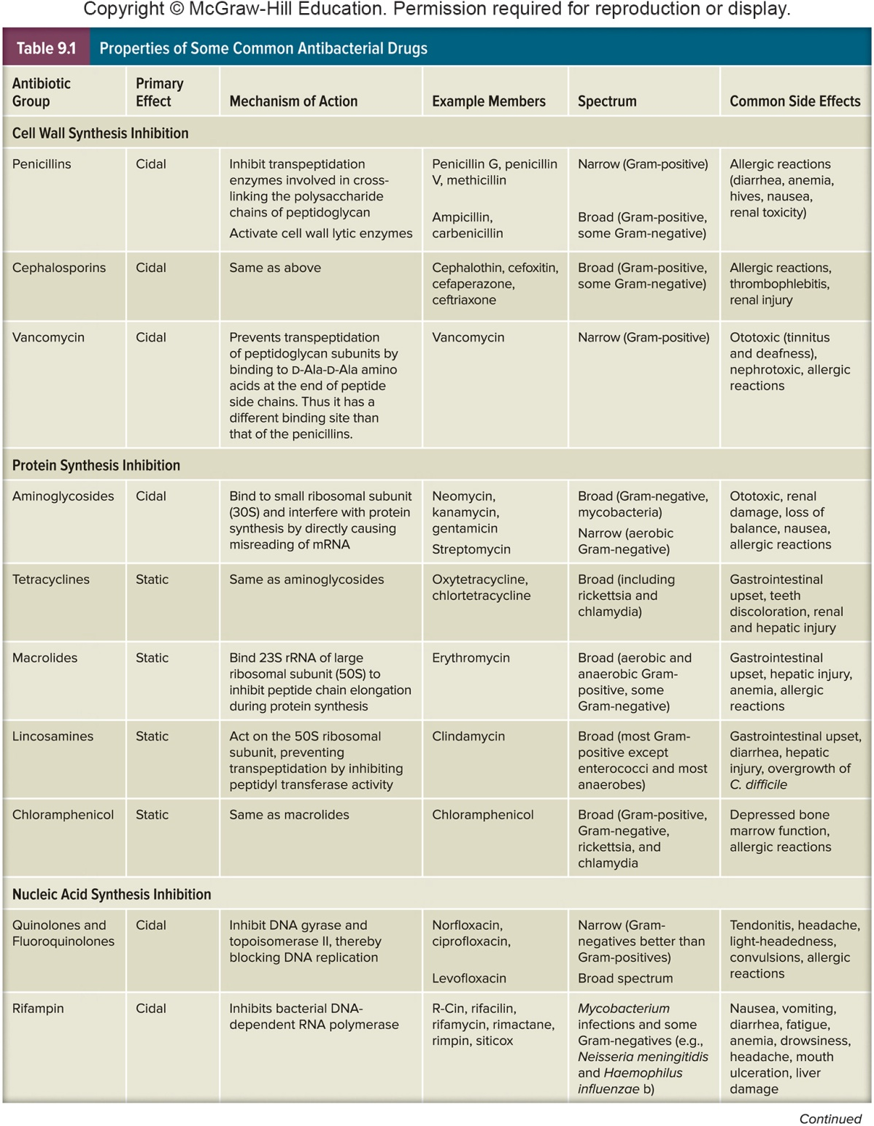
Properties of Antimicrobial Drugs

Slide 11
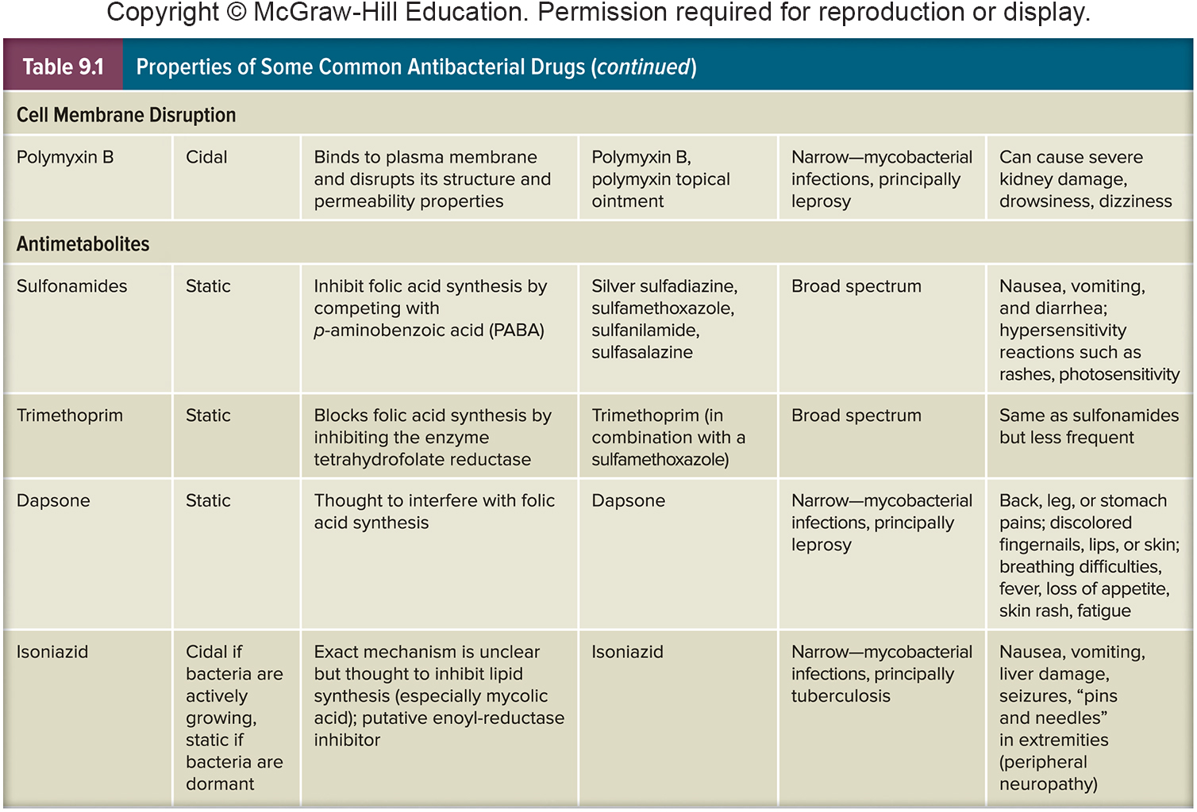
Further Properties of Antibacterial Drugs

Slide 12
Measuring Effectiveness of Antimicrobial Drugs
Effect of an agent may vary
with concentration, microbe, host
Effectiveness expressed in two ways
minimal inhibitory concentration (MIC)
lowest concentration of drug that inhibits growth of pathogen
minimal lethal concentration (MLC)
lowest concentration of drug that kills pathogen

Slide 13
9.3 Antimicrobial Activity Can Be Measured by Specific Tests
Explain how to determine the level of antibacterial drug activity using the dilution susceptibility test, the disk diffusion test, and the Etest
Predict antimicrobial drug levels in vivo from in vitro data

Slide 14
Determining the Level of Antimicrobial Activity
Dilution susceptibility tests for MIC
Disk diffusion tests – Kirby Bauer
The E-test MIC and diffusion

Slide 15
Dilution Susceptibility Tests
Involves inoculating media containing different concentrations of drug
broth or agar with lowest concentration showing no growth is MIC
if broth used, tubes showing no growth can be subcultured into drug-free medium
broth from which microbe can’t be recovered is MLC

Slide 16
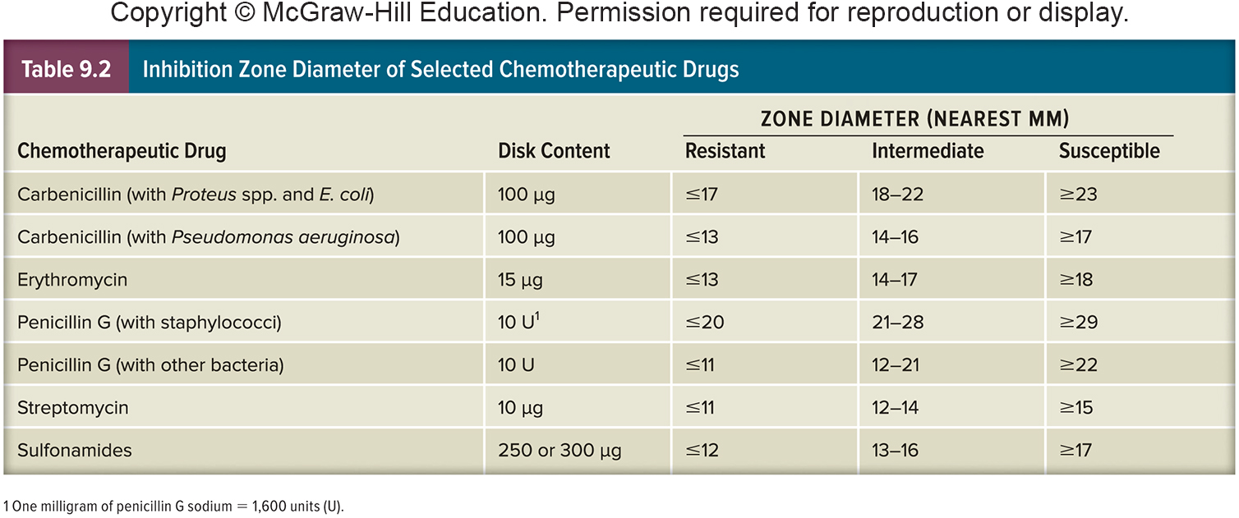
Disk Diffusion Tests
Disks impregnated with specific drugs are placed on agar plates inoculated with test microbe
Drug diffuses from disk into agar, establishing concentration gradient
Observe clear zones (no growth) around disks

Slide 17
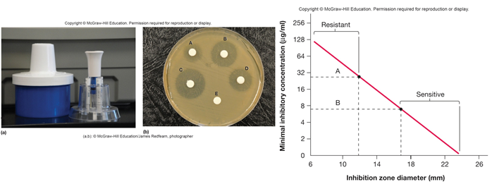
Kirby-Bauer Method
Standardized method for disk diffusion test
Sensitivity/resistance determined using tables relating zone diameter with microbial resistance
Table values plotted, used to determine if effective concentration of drug in body can be reached

Slide 18
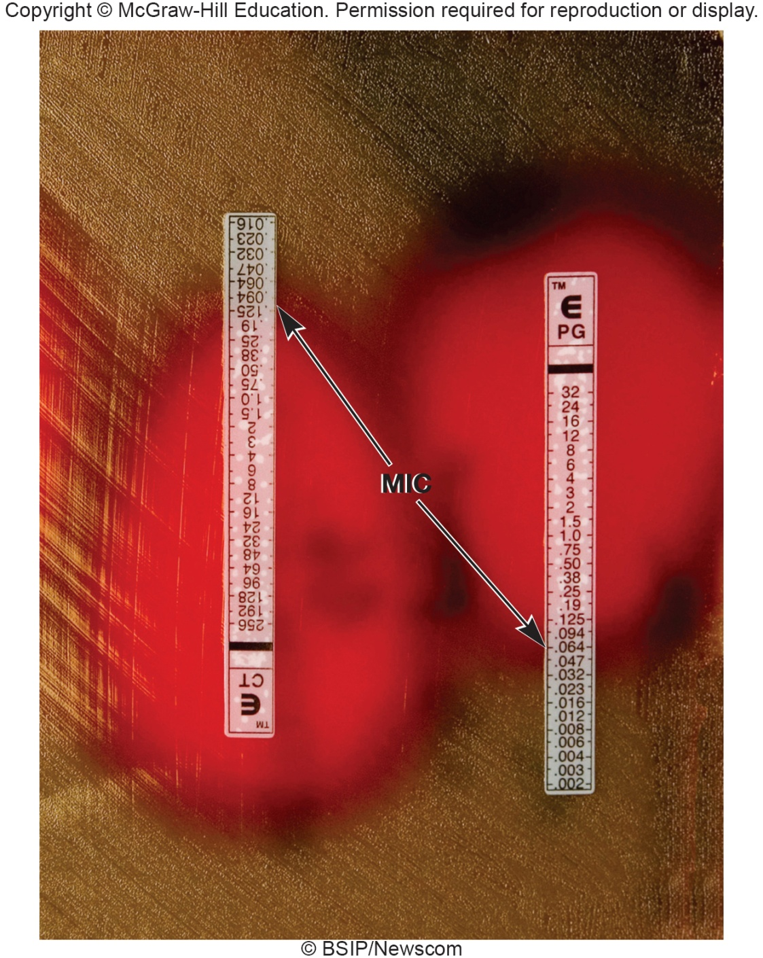
The Etest®
Convenient for use with anaerobic pathogens
Similar to disk diffusion method, but uses strip rather than disk
Etest strips contain a gradient of an antibiotic
Intersection of elliptical zone of inhibition with strip indicates MIC

Slide 19
9.4 Antibacterial Drugs
Compare antibacterial drug mechanisms of action
Correlate lack of microbial growth with selective toxicity
Relate side effect toxicity of antibacterial drugs to mechanism of action
Explain the relative effectiveness of various antibacterial agents based on drug target

Slide 20
Antimicrobial Drugs – Main Modes of Action
Inhibitors of cell wall synthesis
Protein synthesis inhibitors
Metabolic antagonists
Nucleic acid synthesis inhibition

Slide 21
Inhibitors of Cell Wall Synthesis
Penicillins
most are 6-aminopenicillanic acid derivatives and differ in side chain attached to amino group
most crucial feature of molecule is the β-lactam ring
essential for bioactivity
many penicillin resistant organisms produce β-lactamase (penicillinase) which hydrolyzes a bond in this ring

Slide 22
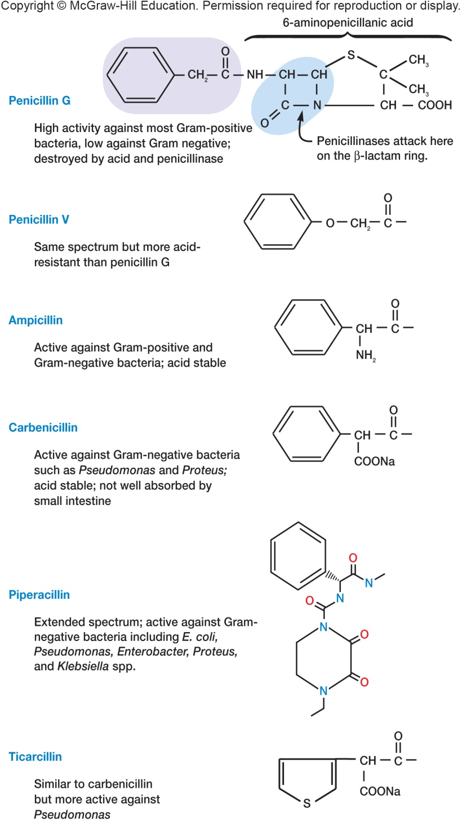
Penicillins - Structures
Mode of action
blocks the enzyme that catalyzes transpeptidation (formation of cross-links in peptidoglycan)
prevents the synthesis of complete cell walls leading to lysis of cell
acts only on growing bacteria that are synthesizing new peptidoglycan

Slide 23
Other Actions and Types of Penicillins
Binds to periplasmic proteins (penicillin-binding proteins, PBPs)
May activate bacterial autolysins and murein hydrolases
Stimulate bacterial holins to form holes or lesions in the plasma membrane
Naturally occurring penicillins
penicillin V and G are narrow spectrum
Semisynthetic penicillins have a broader spectrum than naturally occurring ones
Resistance to penicillins, including the semisynthetic analogs, continues to be a problem
~1–5% of adults in U.S. are allergic to penicillin
allergy can lead to a violent allergic response and death

Slide 24
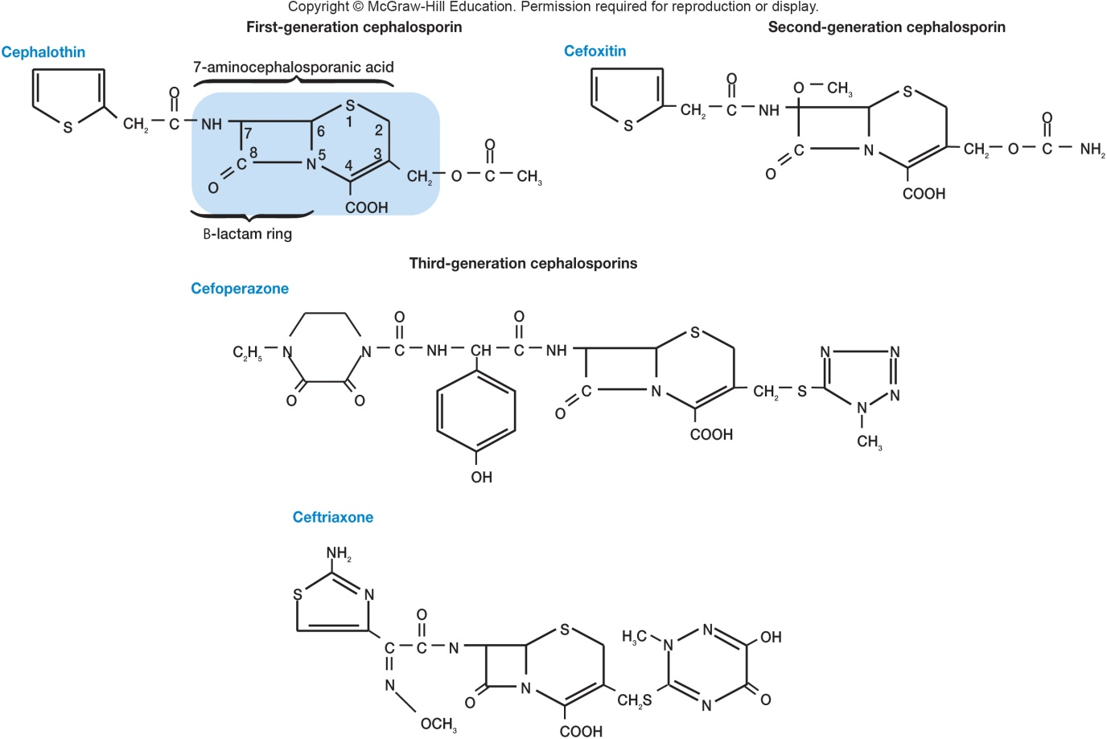
Cephalosporins
Structurally and functionally similar to penicillins
Broad-spectrum antibiotics that can be used by most patients that are allergic to penicillin
Four categories based on their spectrum of activity

Slide 25
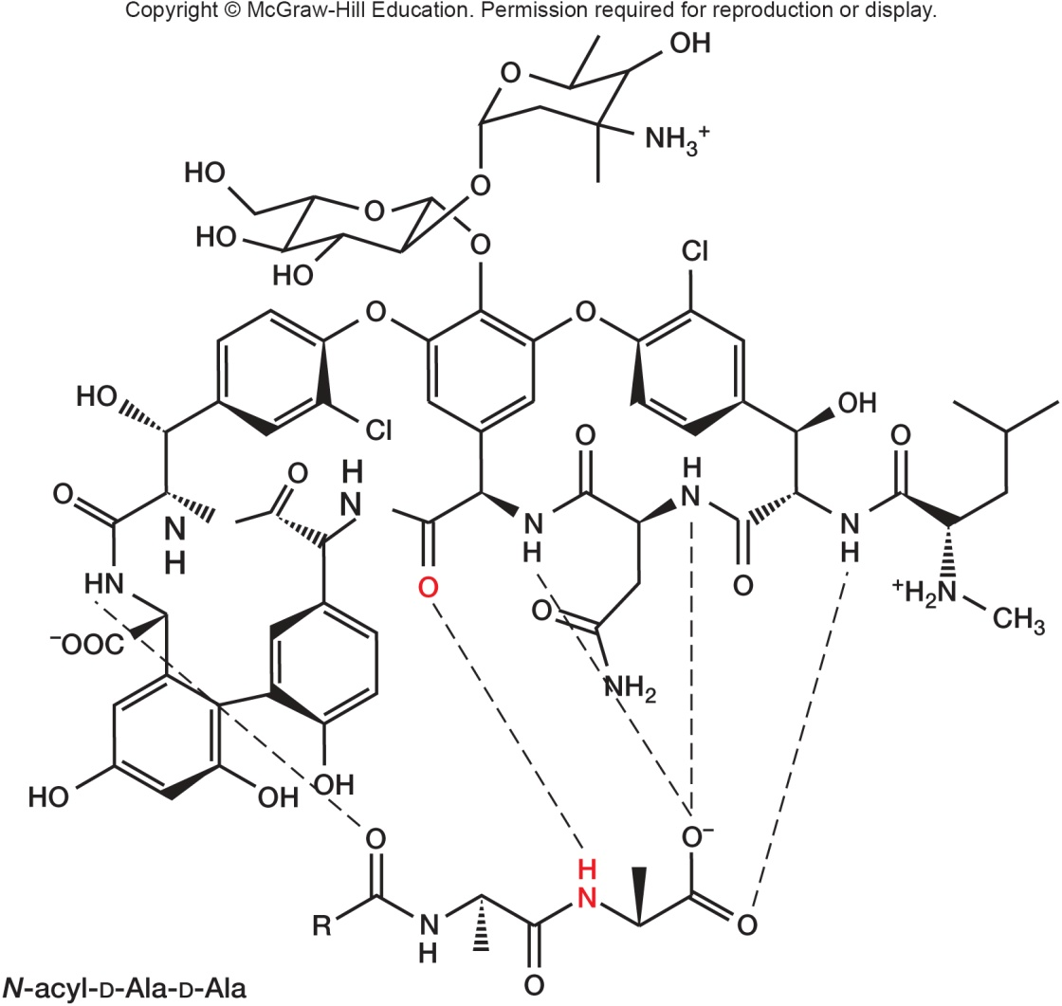
Vancomycin and Teicoplanin
Glycopeptide antibiotics
Inhibit cell wall synthesis
Vancomycin - important for treatment of antibiotic-resistant staphylococcal and enterococcal infections
previously considered “drug of last resort” so rise in resistance to vancomycin is of great concern

Slide 26
Protein Synthesis Inhibitors
Many antibiotics bind specifically to the bacterial ribosome
binding can be to 30S (small) or 50S (large) ribosomal subunit
Other antibiotics inhibit a step in protein synthesis
aminoacyl-tRNA binding
peptide bond formation
mRNA reading
translocation

Slide 27
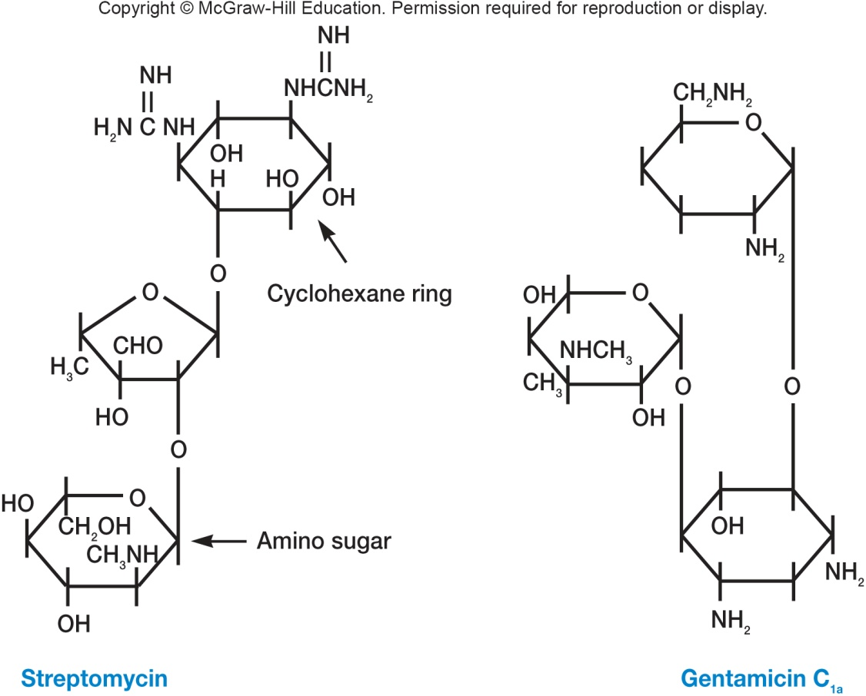
Aminoglycoside Antibiotics
Large group, all with a cyclohexane ring, amino sugars
Bind to 30S ribosomal subunit, interfere with protein synthesis by directly inhibiting the process and by causing misreading of the messenger RNA
Resistance and toxicity

Slide 28
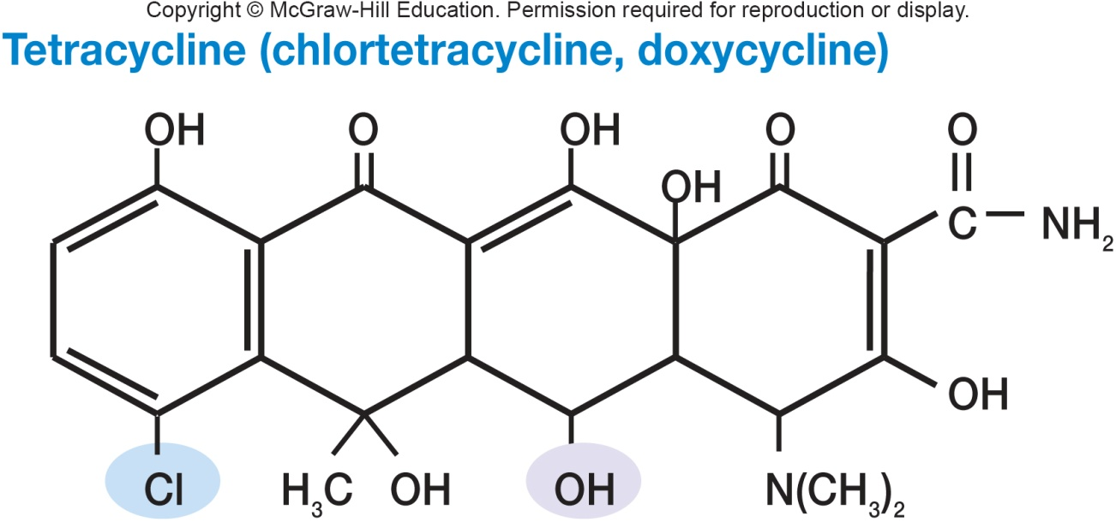
Tetracyclines
All have a four-ring structure to which a variety of side chains are attached
Are broad spectrum, bacteriostatic
Combine with 30S ribosomal subunit
inhibits bind of aminoacyl-tRNA molecules to the A site of the ribosome
Sometimes used to treat acne

Slide 29
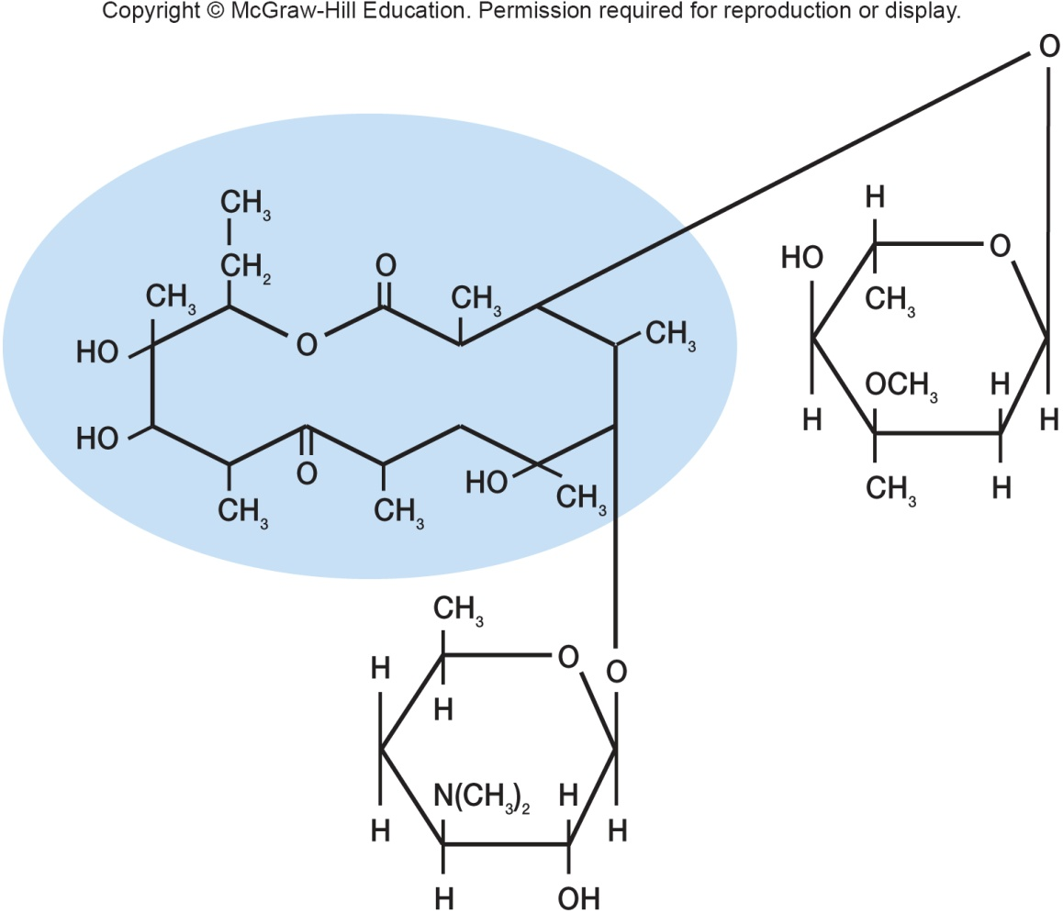
Macrolides
Contain 12- to 22-carbon lactone rings linked to one or more sugars
e.g. erythromycin
broad spectrum, usually bacteriostatic
binds to 23S rRNA of 50S ribosomal subunit
inhibits peptide chain elongation
Used for patients allergic to penicillin

Slide 30
Lincosamines
Interferes with protein synthesis in microbes
Produced by Streptomyces bacteria
Broad spectrum of antibiotic activity against anaerobic microbes; less activity against aerobes
Used sparingly because they can support (indirectly) the growth of C. difficile, which can result in other disease states
Clindamycin is an example, and is used to treat infections caused by Bacteroides fragilis, as well as some staphylococcal and streptococcal infections

Slide 31
Chloramphenicol
Now is chemically synthesized
Binds to 23s rRNA on 50S ribosomal subunit and inhibits peptidyl transferase reaction
Toxic with numerous side effects so only used in life-threatening situations

Slide 32
Metabolic Antagonists
Act as antimetabolites
antagonize or block functioning of metabolic pathways by competitively inhibiting the use of metabolites by key enzymes
Are structural analogs
molecules that are structurally similar to, and compete with, naturally occurring metabolic intermediates
block normal cellular metabolism

Slide 33
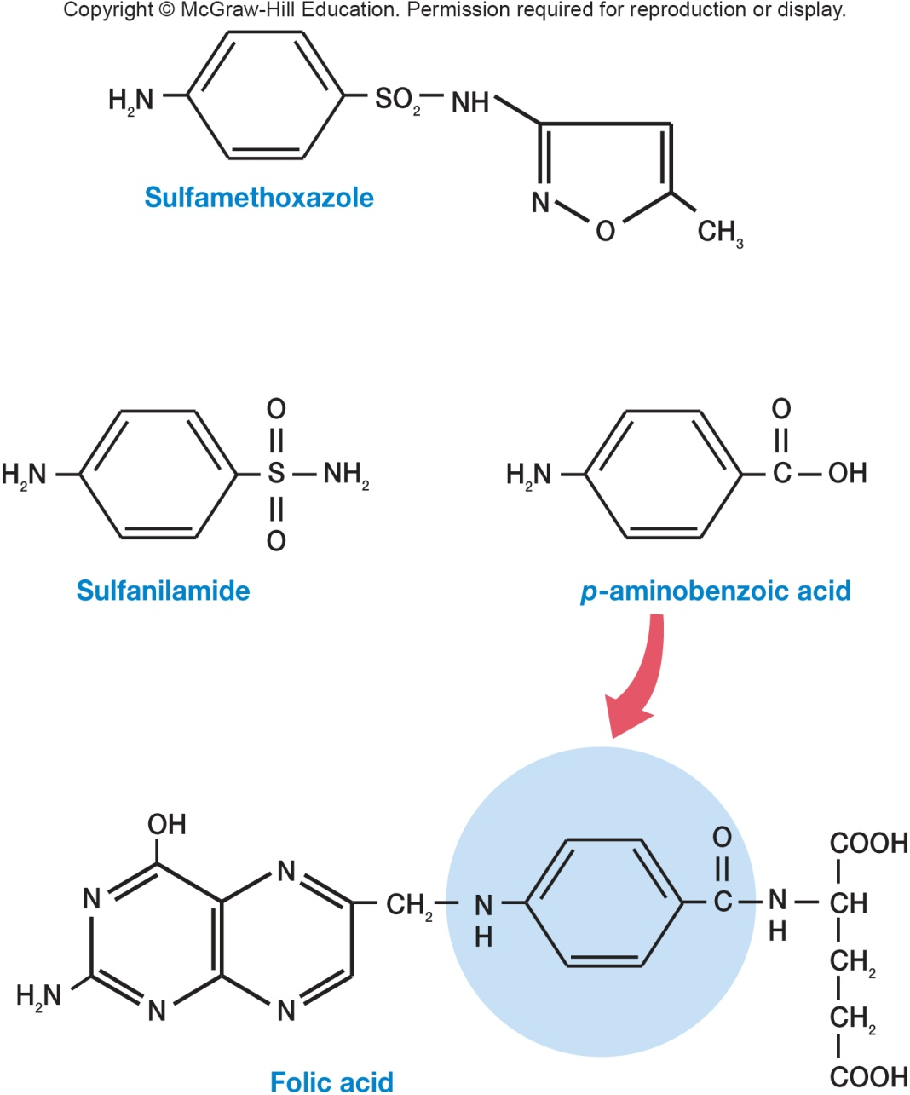
Sulfonamides or Sulfa Drugs
Structurally related to sulfanilamide, a para aminobenzoic acid (PABA) analog
PABA used for the synthesis of folic acid and is made by many pathogens
sulfa drugs are selectively toxic due to competitive inhibition of folic acid synthesis enzymes

Slide 34
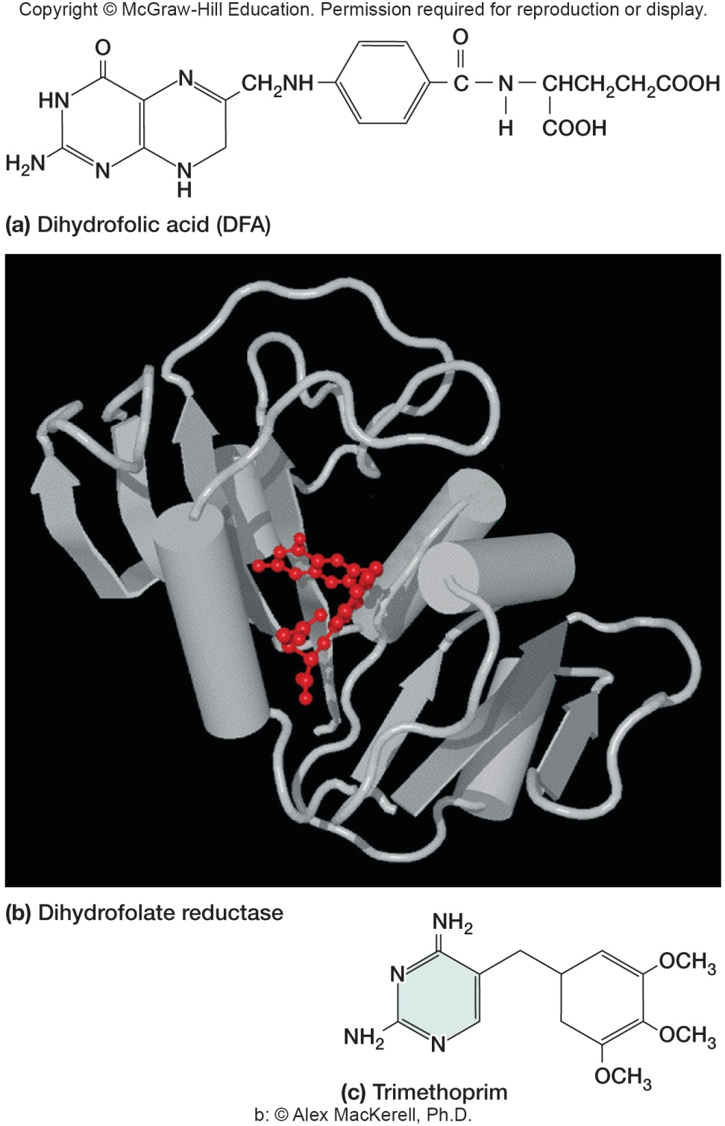
Trimethoprim
Synthetic antibiotic that also interferes with folic acid production
Broad spectrum
Can be combined with sulfa drugs to increase efficacy of treatment
combination blocks two steps in folic acid pathway
Has a variety of side effects including abdominal pain and photosensitivity reactions

Slide 35
Nucleic Acid Synthesis Inhibition
A variety of mechanisms
block DNA replication
inhibition of DNA polymerase
inhibition of DNA helicase
block transcription
inhibition of RNA polymerase
Drugs not as selectively toxic as other antibiotics because bacteria and eukaryotes do not differ greatly in the way they synthesize nucleic acids

Slide 36
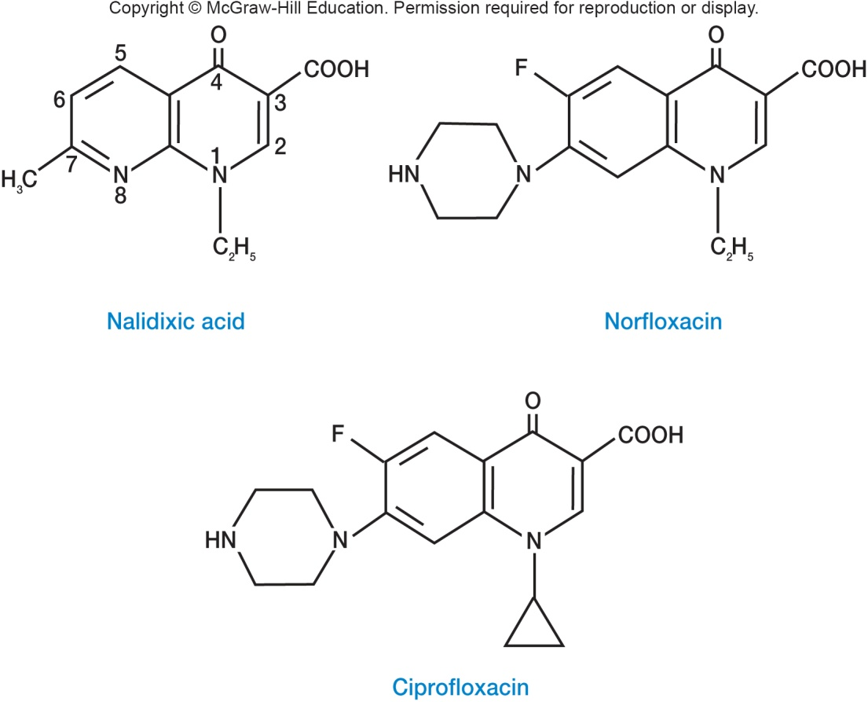
Quinolones
Broad-spectrum, synthetic drugs containing the 4-quinolone ring
Nalidixic acid first synthesized quinolone (1962)
Act by inhibiting bacterial DNA-gyrase and topoisomerase II
Broad spectrum, bactericidal, wide range of infections

Slide 37
9.5 Antifungal Drugs
Compare antifungal drug mechanisms of action
Explain why there are far fewer antifungal agents than there are antibacterial agents

Slide 38
Antifungal Drugs
Fewer effective agents because of similarity of eukaryotic fungal cells and human cells
many have low therapeutic index and are toxic
Easier to treat superficial mycoses than systemic infections
combinations of drugs may be used

Slide 39
Treating Mycoses
Superficial mycoses
e.g. Candida
topical and oral
disrupt membrane permeability and inhibit sterol synthesis
disrupts mitotic spindle; may inhibit protein and DNA synthesis
Systemic mycoses
difficult to control and can be fatal
three common drugs
amphotericin B - binds sterols in membranes
5-flucytosine – disrupts RNA function
fluconazole
low side effects, used prophylactically

Slide 40
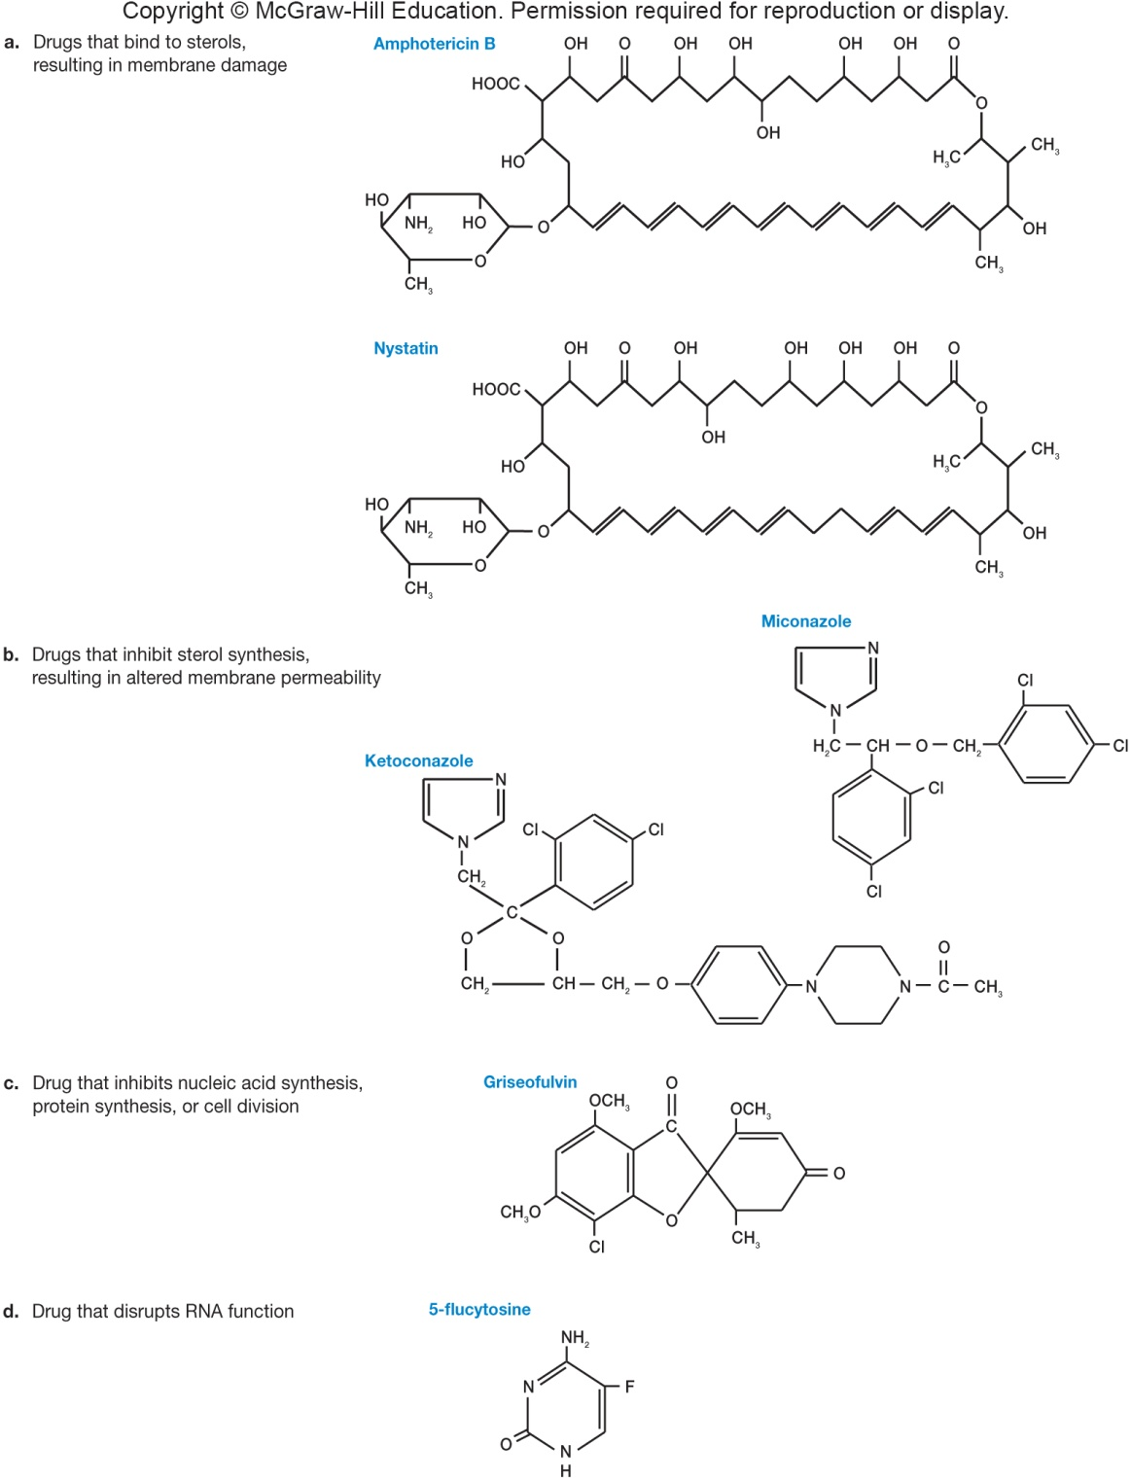
Common Antifungal Drugs

Slide 41
9.6 Antiviral Drugs
Compare antiviral drug mechanisms of action
Provide a rationale for combination drug therapy, using an anti-HIV model
Explain why there are far fewer antiviral agents than there are antibacterial agents

Slide 42
Antiviral Drugs
Drug development has been slow because it is difficult to specifically target viral replication
Drugs currently used inhibit virus-specific enzymes and life cycle processes

Slide 43
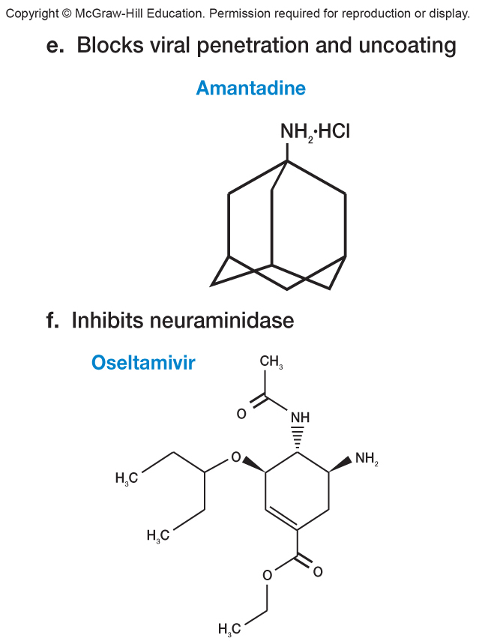
Antiviral Drugs for Influenza
Amantidine
used to prevent influenza infections
blocks penetration and uncoating of influenza virus
Tamiflu
anti-influenza agent
a neuraminidase inhibitor
though not a cure for influenza, has been shown to shorten course of illness

Slide 44
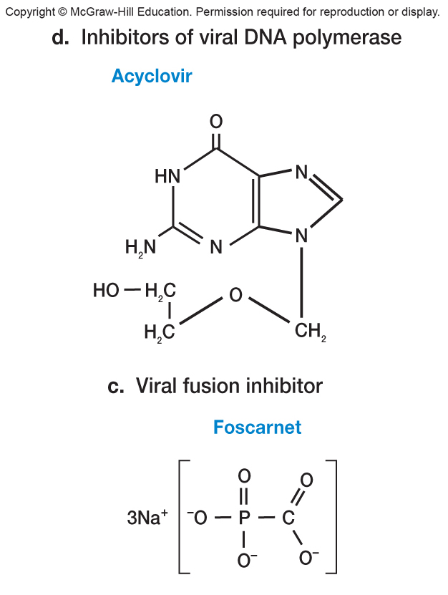
Antiviral Drugs for Herpesvirus Infections
Acyclovir
inhibits herpes virus DNA polymerase
Adenine arabinoside (vidarabine)
inhibits herpes virus enzymes involved in DNA and RNA synthesis and function
Valacyclovir
prodrug form of acyclovir
Ganciclovir and others
anti-herpesvirus drugs
Foscarnet
inhibits herpes virus DNA polymerase

Slide 45
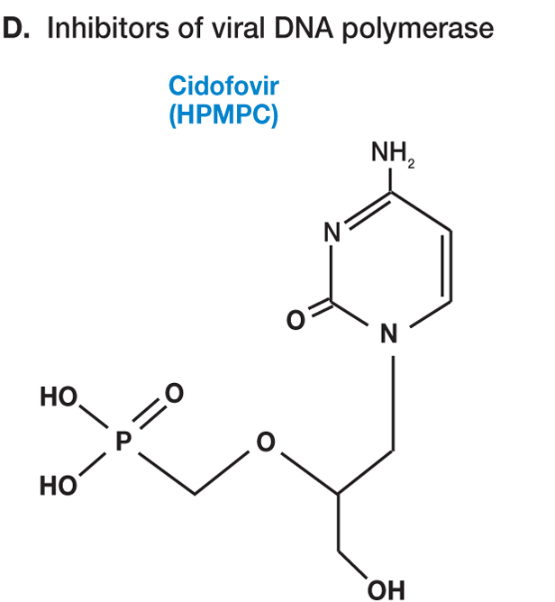
Broad Spectrum Antiviral Drugs
Broad spectrum anti-DNA virus drugs
HPMPC (cidofovir)
inhibits viral DNA polymerase papovaviruses, adenoviruses, herpesviruses iridoviruses, and poxviruses

Slide 46
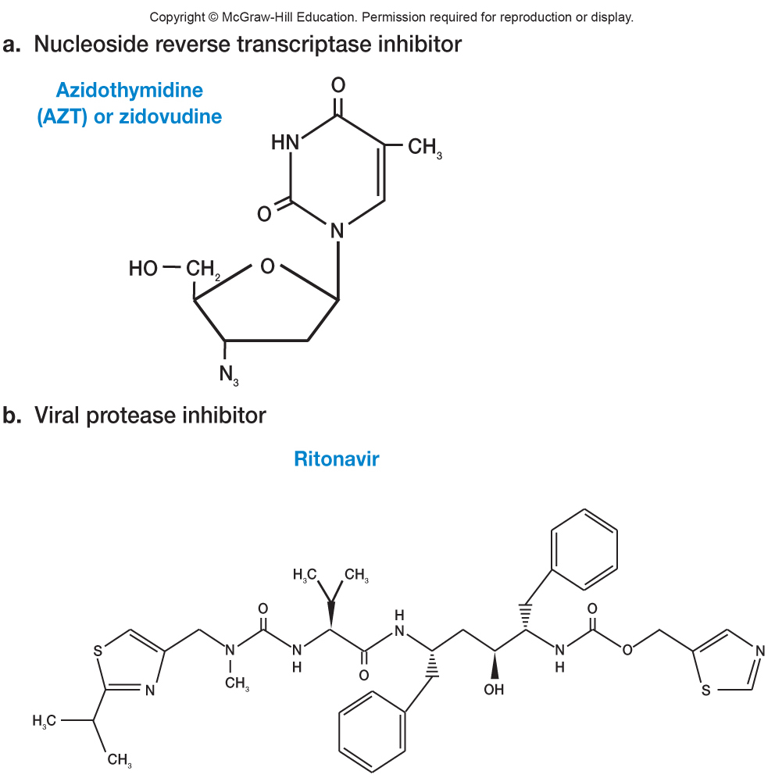
Anti-HIV Drugs
Reverse transcriptase (RT) inhibitors
nucleoside RT inhibitors
non-nucleoside RT inhibitors
Protease inhibitors
mimic peptide bond that is normally attacked by the protease
Fusion inhibitors
prevent HIV entry into cells
Most successful are drug cocktails to curtail resistance

Slide 47
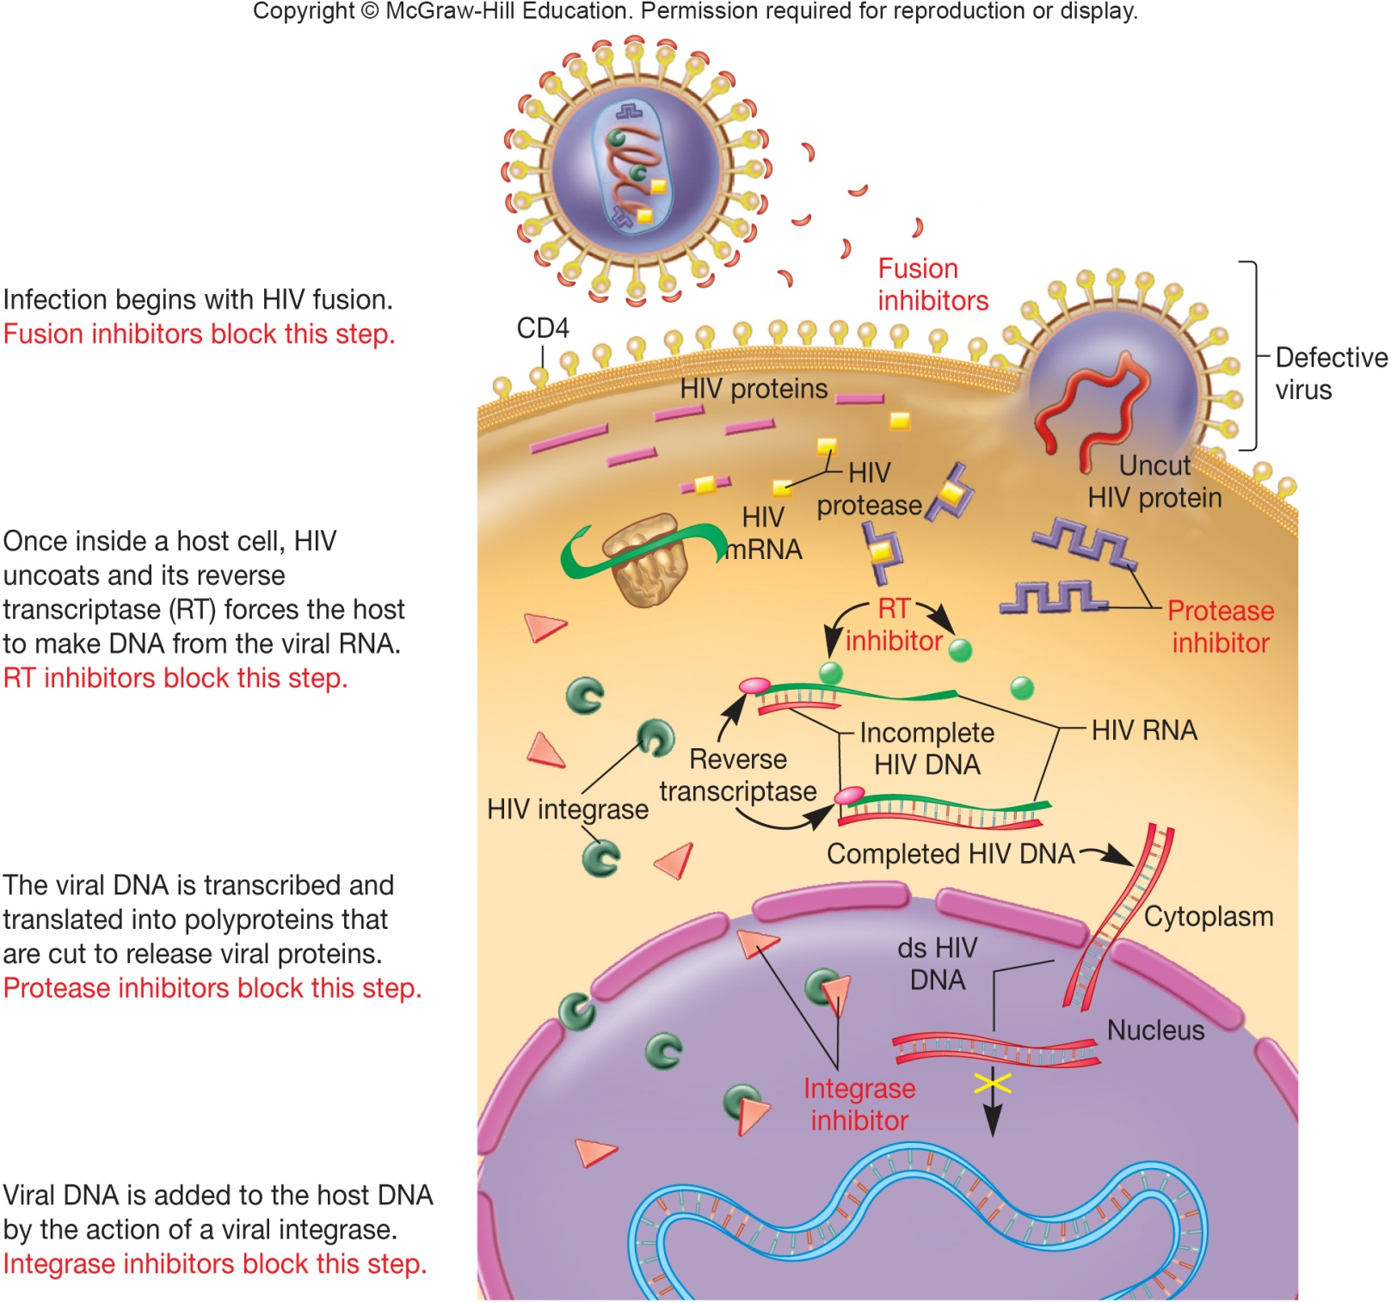
Identifying Targets for Anti-HIV Drugs

Slide 48
9.7 Antiprotozoan Drugs
Compare the mechanisms of action of antiprotozoan drugs
Relate side effects and toxicity of antiprotozoan drugs to their mechanisms of action
Explain why there are far fewer antiprotozoan agents than there are antibacterial agents

Slide 49
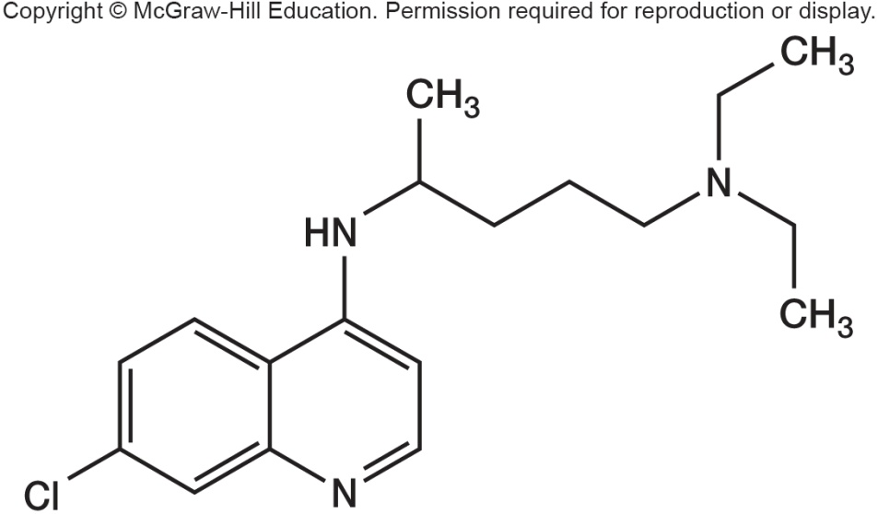
Antiprotozoan Drugs
The mechanism of drug action for many antiprotozoal drugs is not precisely known
Examples of available drugs
some antibiotics that inhibit bacterial protein synthesis are used against protozoa
chloroquine and mefloquine – malaria
metronidazole – Entamoeba infections
atovaquone – Pneumocystis carinii and Toxoplasma gondii

Slide 50
9.8 Several Factors Influence Antimicrobial Drug Effectiveness
Predict the effects of (1) delivery route, (2) metabolism, and (3) local concentration on the effectiveness of an antimicrobial drug
Correlate the sensitivity of a microorganism to an antimicrobial agent with microbial growth in the presence of that agent
Identify the practices that lead to antimicrobial drug resistance and suggest countermeasures

Slide 51
Factors Influencing Antimicrobial Drugs
Ability of drug to reach site of infection
Susceptibility of pathogen to drug
Ability of drug to reach concentrations in body that exceed MIC of pathogen

Slide 52
Ability of Drug to Reach Site of Infection
Depends in part on mode of administration
oral
some drugs destroyed by stomach acid
topical
parenteral routes
nonoral routes of administration
Drug can be excluded by blood clots or necrotic tissue

Slide 53
Factors Influencing Ability of Drug to Reach Concentrations Exceeding MIC
Amount administered
Route of administration
Speed of uptake
Rate of clearance (elimination) from body

Slide 54
Drug Resistance
An increasing problem
once resistance originates in a population it can be transmitted to other bacteria
a particular type of resistance mechanism is not confirmed to a single class of drugs
Microbes in abscesses or biofilms may be growing slowly and not be susceptible
Resistance mutants arise spontaneously and are then selected

Slide 55
Overcoming Drug Resistance
Give drug in appropriate concentrations to destroy susceptible
Give two or more drugs at same time
Use drugs only when necessary
Possible future solutions
continued development of new drugs
use of bacteriophages to treat bacterial disease

Slide 56
Take Home Message
Use of drugs to control microbial growth has played a pivotal role in development of healthy societies across the last century or so of history
We need to understand how these drugs work in order to develop more of them, but also to try to counter evolution of resistance against them by microbes
Work to go beyond memorizing a mechanism or a structure for these drugs – ask yourself WHY they work the way they do, as well as what methods microbes may try to use to avoid being controlled or killed

